Slide 1

SCENARIO
TEAM PROJET
Build an e-commerce application
Can you give me the process
to accomplish this project?
Rose
Maurice
Leirisse
Leo
VPC
Subnet
IGW/Route
Ec2/codes
Get together
List the requirements
Network
Compute
Security
Ec2 codes
Assign tasks each person
Provide timeframe
How do we collaborate on this project?
Schedule daily meeting
We depend on each other
We have to know at each time what others have done

Slide 2
You can master how to achieve your task or manage your individual project but if you don’t know how to collaborate, you can’t work in a company.
Get together
To communicate together
To share information
MS Teams | Sharepoint | Online Drive
List the requirements
Assign tasks each person
Provide timeframe
MS Projects
Schedule daily meeting ➔
JIRA form Atlassian (How to manage a project)
VERSION CONTROL SYSTEM (VCS) - GIT
GIT: Tool or Technology to enhance collaboration
Version control systems are a category of software tools that helps in recording changes (modifications to the source code either by adding or removing) made to files by keeping a track of modifications done in the code.
A separate branch is created for every member who made the changes and the changes aren’t merged into the original source code unless all are analyzed, as soon as the changes are green signaled they merged to the main source code.

Slide 3
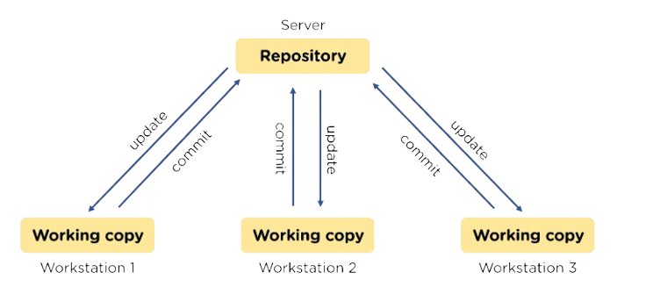
Types of VCS
Distributed Version Control Systems
A copy of a central repository
Centralized Version Control Systems
Online repo where you store code
Benefits of VCS
Track all changes happening to the project
Make collaboration easy and smooth
Gain great overview on the project
Enhances the project development speed by providing efficient collaboration
Reduce possibilities of errors and conflicts meanwhile project development through traceability to every small change
For each different contributor to the project, a different working copy is maintained and not merged to the main file unless the working copy is validated
Helps in recovery in case of any disaster or contingent situation
Informs us about Who, What, When, Why changes have been made

Slide 4

MASTER / MAIN BRANCH
The process with VCS
MERGE the code
3b
Verify & validate the code
3a
Maurice branch
Rose branch
1
CENTRAL/ONLINE REPOSITORY
Projects Branches
4
Upload a content from a local Repo to a Central Repo
Everyone connected to the central repo will be notified that a new code have been push
PUSH
PULL
5
3
Download a content from a central Repo to a local Repo
Write the code
Add the change and push back to the central repo
2
6
My local Repository
My local Repository

Slide 5
GIT COMMANDS
git init | initialize your git project
git add | add a change to your git project
git commit | commit/save/capture a change made to your git project
git push | push/move/send your changes to your online repo
git pull | pull/download from online to your local repo
git status| track any change happen in your project

Slide 6
Centralized VCS
Git is a Distributed VCS ➔ To work properly, we need to associate to it a Centralized VCS where we will have a Central or main repository
Some of the CVCS
GitHub is a CVCS or a website acting as a platform for Git. The most use. Open source.
BitBucket from Atlassian (open source)
Amazon S3 Bucket
Azure Repo from MicroSoft
AWS CodeCommit from AWS

Slide 7
DEMO SESSION
Check if Git is already installed in your computer.
Sign up and create your account in GitHub
Sign up and create your account in GitHub
www.github.com
Add your email and username to Git
git config - -global user.mail “your github email”
git config - -global user.name “your github username”
git config -list ➔ to see your email and username registered
Add files and folders to Git
Git Commands
git init
git status (if no commit, add a file and type the same command again
git add + your file name
git status (to confirm that the file have been added and tracked to git
git commit –m “your message before committing your change”
Edit the content of your file
Add another file to your folder
git status
git add.
git status (to confirm that everything is clean)

